Slide 1
Project Round 4 Update
Group D

Slide 2
01
GitHub Repo & Project Status Report

Slide 3
02
Sprint Backlog

Slide 4
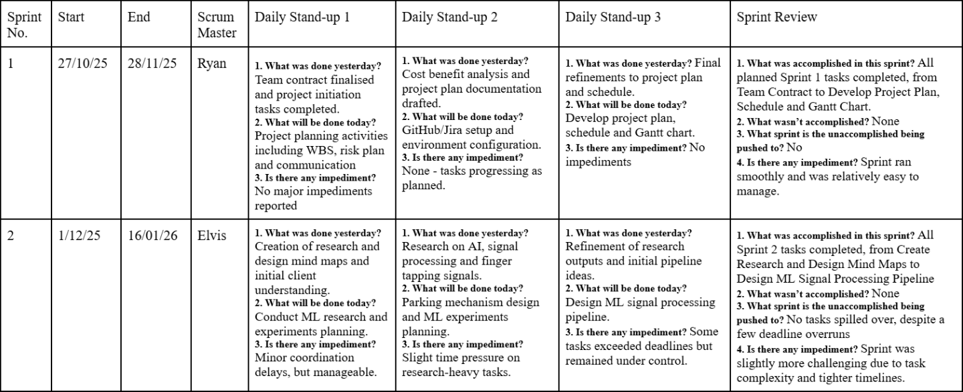
03
Sprint Retrospective

Slide 5
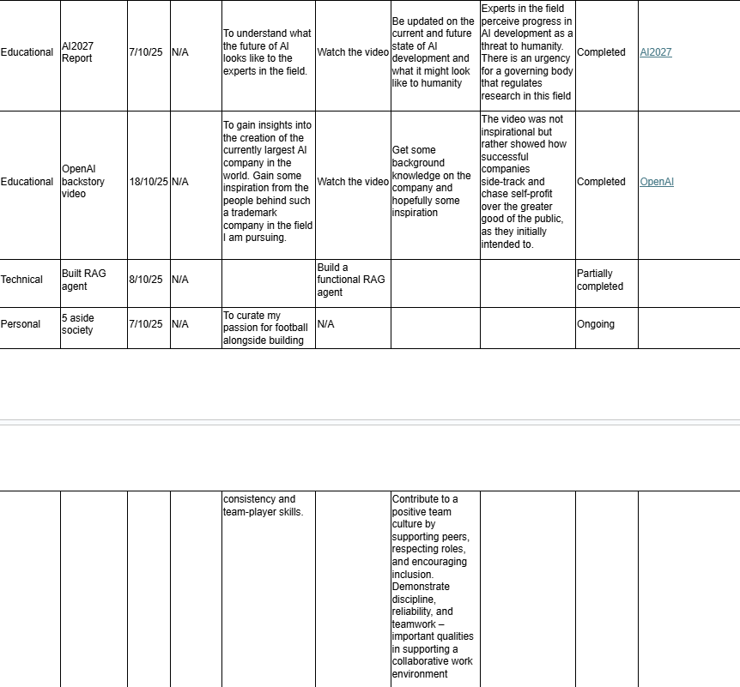
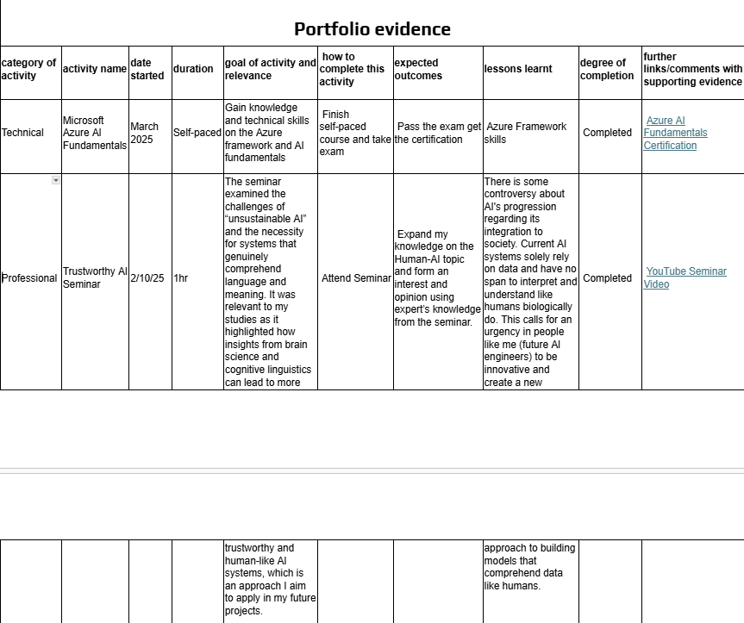


04
Individual Portfolio Snapshot

